Slide 1
Deep Learning Tutorial
李宏毅
Hung-yi Lee

Slide 2
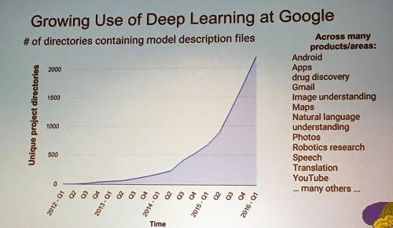
Deep learning attracts lots of attention.
I believe you have seen lots of exciting results before.
Deep learning trends at Google. Source: SIGMOD/Jeff Dean
This talk focuses on the basic techniques.
Notes:
Google DeepMind團隊將以機器學習技術分析匿名的視網膜掃瞄圖像資料

Slide 3
Outline
Lecture II: Variants of Neural Network
Lecture I: Introduction of Deep Learning
Lecture III: Beyond Supervised Learning

Slide 4
Lecture I: Introduction of Deep Learning
Notes:
Actually for every machine learning
Three things: model, cost, learning

Slide 5
Outline
“Hello World” for Deep Learning
Introduction of Deep Learning
Tips for Deep Learning
Notes:
The three steps can also apply on other machine learning methods

Slide 6
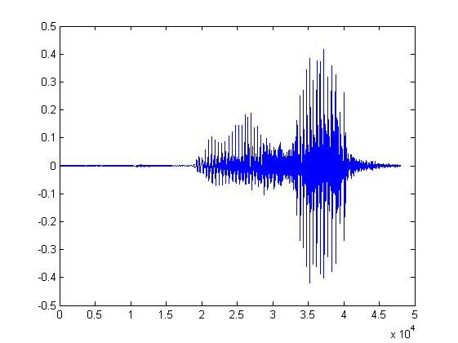

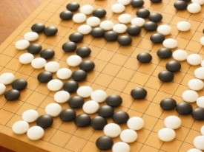
Machine Learning ≈ Looking for a Function
Speech Recognition
Image Recognition
Playing Go
Dialogue System
“How are you”
“Cat”
“5-5”
(next move)
“Hi”
“Hello”
(what the user said)
(system response)

Slide 7
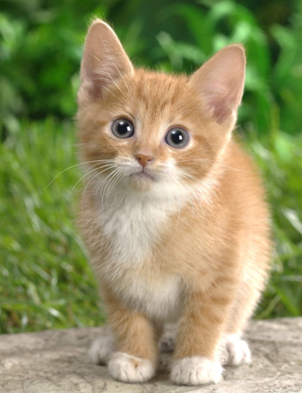

Framework
Image Recognition:
“cat”
A set of function
Model
“cat”
“money”
“dog”
“snake”
Notes:
以图像识别任务为例，我们假设设计了一系列函数，这些函数称之为模型

Slide 8
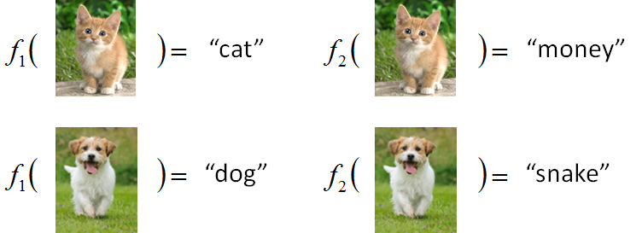
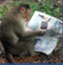
Framework
Image Recognition:
“cat”
A set of function
Model
Better!
Goodness of function f
Supervised Learning
Training
Data
function input:
function output:
“monkey”
“cat”
“dog”
Notes:
对于一个函数，就要有输入和输出，我们把这些输入和输出称之为训练集。函数的输入和期望输出我们都是已知的-训练集

Slide 9
Framework
Image Recognition:
“cat”
A set of function
Model
Training
Testing
“cat”
Step 1
Goodness of function f
Pick the “Best” Function
Using
Step 2
Step 3
Training
Data
“monkey”
“cat”
“dog”
Notes:
Repeat again

Slide 10
Three Steps for Deep Learning
Step 1: define a set of function
Step 2: goodness of function
Step 3: pick the best function
Neural Network

Slide 11
Neural Network
Neuron
A simple function
…
…
…
…
Activation function
weights
bias
Notes:
sigmoid

Slide 12
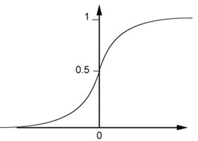
Neural Network
Neuron
Sigmoid Function
2
1
4
-1
-2
0.98
Activation function
-1
1
weights
1
bias
Notes:
sigmoid

Slide 13
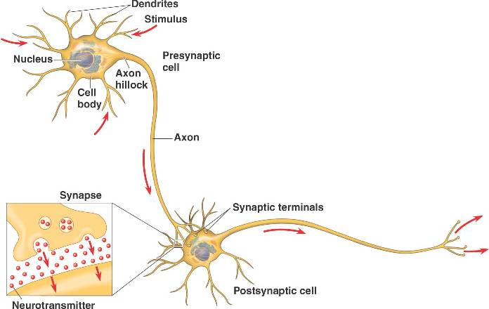
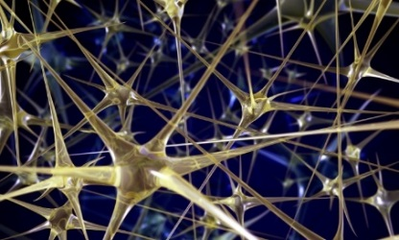
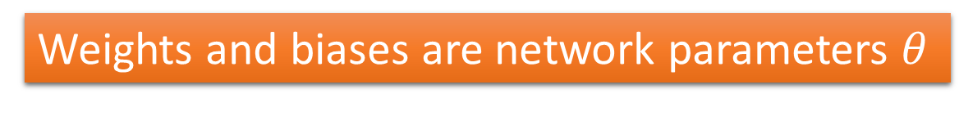
Neural Network
Different connections lead to different network structures
The neurons have different values of weights and biases.
Weights and biases are network parameters $θ$
Notes:
The values of weights and biases will be obtained by learning (step 3).

Slide 14
Fully Connect Feedforward Network
1
4
0.98
1
-2
1
-1
-2
0.12
-1
1
0
Sigmoid Function

Slide 15
Fully Connect Feedforward Network
1
4
0.98
2
0.86
3
0.62
1
-2
-1
-1
1
0
-2
-1
-2
0.12
-2
0.11
-1
0.83
-1
1
-1
4
0
0
2

Slide 16
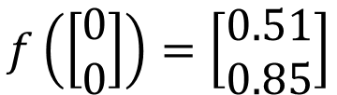
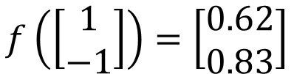
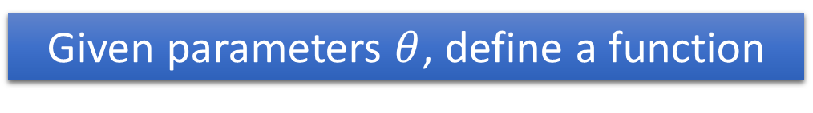
Fully Connect Feedforward Network
1
0.73
2
0.72
3
0.51
0
-2
-1
-1
1
0
-2
-1
0.5
-2
0.12
-1
0.85
0
1
-1
4
0
0
2
This is a function.
$$f\left(\left[\begin{matrix}1 \\ −1\end{matrix}\right]\right)=\left[\begin{matrix}0.62 \\ 0.83\end{matrix}\right]$$
$$f\left(\left[\begin{matrix}0 \\ 0\end{matrix}\right]\right)=\left[\begin{matrix}0.51 \\ 0.85\end{matrix}\right]$$
Input vector, output vector
Given parameters $θ$, define a function
Given network structure, define a function set
Notes:
For example, if we modify “1” to “2”, then we have another function

Slide 17
Fully Connect Feedforward Network
neuron
Input
Layer 1
Layer 2
Layer L
Output
……
y₁
……
y₂
……
……
……
……
……
……
y_{M}
Input Layer
Output Layer
Hidden Layers
Deep means many hidden layers

Slide 18
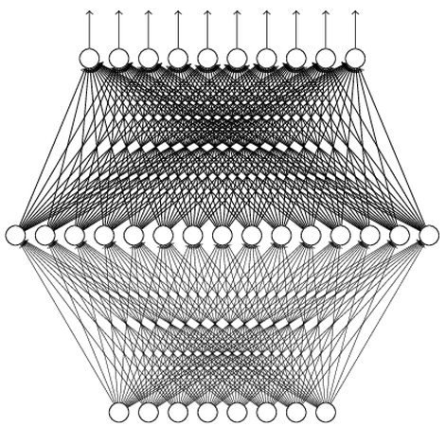
Why Deep? Universality Theorem
Any continuous function f
Can be realized by a network with one hidden layer
(given enough hidden neurons)
Reference for the reason: http://neuralnetworksanddeeplearning.com/chap4.html
Why “Deep” neural network not “Fat” neural network?

Slide 19
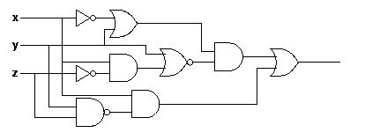
Why Deep? Analogy
Logic circuits
Neural network
Logic circuits consists of gates
A two layers of logic gates can represent any Boolean function.
Using multiple layers of logic gates to build some functions are much simpler
Neural network consists of neurons
A hidden layer network can represent any continuous function.
Using multiple layers of neurons to represent some functions are much simpler
less parameters
less data?
less gates needed
More reason: https://www.youtube.com/watch?v=XsC9byQkUH8&list=PLJV_el3uVTsPy9oCRY30oBPNLCo89yu49&index=13

Slide 20
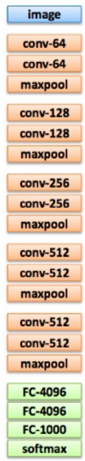
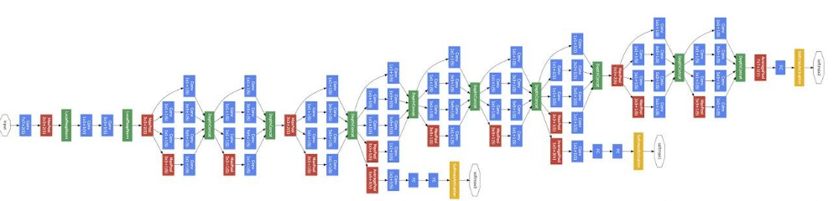
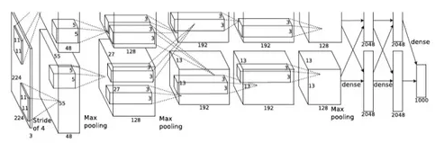
Deep = Many hidden layers
22 layers
http://cs231n.stanford.edu/slides/winter1516_lecture8.pdf
19 layers
8 layers
6.7%
7.3%
16.4%
AlexNet (2012)
VGG (2014)
GoogleNet (2014)

Slide 21
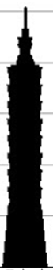
Deep = Many hidden layers
101 layers
152 layers
Special
structure
3.57%
7.3%
6.7%
16.4%
AlexNet (2012)
VGG
(2014)
GoogleNet
(2014)
Residual Net
(2015)
Taipei
101
Notes:
，曾於2004年12月31日至2010年1月4日間擁有世界第一高樓的紀錄

Slide 22
Output Layer
Softmax layer as the output layer
Ordinary Layer
In general, the output of network can be any value.
May not be easy to interpret
Notes:
Original output layer is local

Slide 23
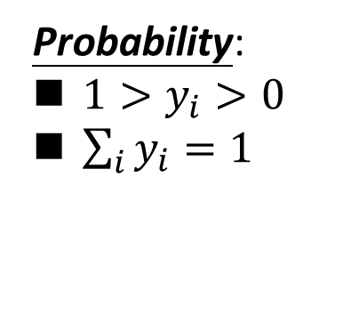
Output Layer
Probability:
$1>y_{i}>0$
$\sum_{i}{y_{i}=1}$
Softmax layer as the output layer
Softmax Layer
3
20
0.88
1
2.7
0.12
-3
0.05
≈0
Notes:
Why it is name soft max?
Monotonicity of softmax
Non-locality of softmax

Slide 24
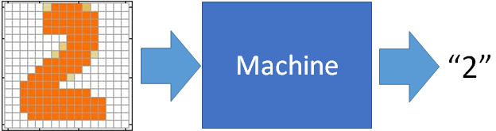
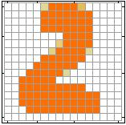
Example Application
Input
Output
y₁
is 1
0.1
y₂
is 2
0.7
The image is “2”
……
……
……
y₁₀
0.2
is 0
16 x 16 = 256
Ink → 1
No ink → 0
Each dimension represents the confidence of a digit.
Notes:
The same for even more complex tasks.

Slide 25
Example Application
Handwriting Digit Recognition
y₁
is 1
Machine
y₂
is 2
Neural
Network
“2”
……
……
……
y₁₀
is 0
What is needed is a function ……
Input:
256-dim vector
output:
10-dim vector
Notes:
The same approach for other cases

Slide 26
Example Application
Input
Layer 1
Layer 2
Layer L
Output
……
y₁
is 1
……
A function set containing the candidates for
Handwriting Digit Recognition
y₂
is 2
“2”
……
……
……
……
……
……
……
y₁₀
is 0
Input Layer
Output Layer
Hidden Layers
You need to decide the network structure to let a good function in your function set.

Slide 27
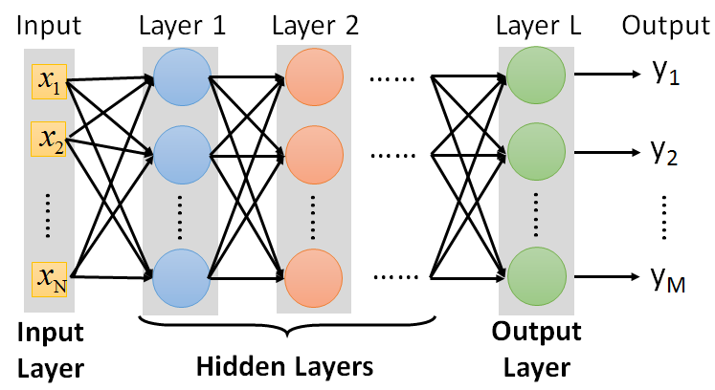
FAQ
Q: How many layers? How many neurons for each layer?
Q: Can we design the network structure?
Q: Can the structure be automatically determined?
Yes, but not widely studied yet.
Trial and Error
+
Intuition
Convolutional Neural Network (CNN) in the next lecture

Slide 28
Highway Network In machine learning, a highway network is an approach to optimizing networks and increasing their depth. Highway networks use learned gating mechanisms to regulate information flow, inspired by Long Short-Term Memory recurrent neural networks
Residual Network
Highway Network
+
copy
Gate controller
copy
Deep Residual Learning for Image Recognition
http://arxiv.org/abs/1512.03385
Training Very Deep Networks
https://arxiv.org/pdf/1507.06228v2.pdf

Slide 29
output layer
output layer
output layer
Highway Network automatically
determines the layers needed!
Input layer
Input layer
Input layer

Slide 30
Three Steps for Deep Learning
Step 1: define a set of function
Step 2: goodness of function
Step 3: pick the best function

Slide 31


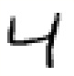





Training Data
Preparing training data: images and their labels
“5”
“0”
“4”
“1”
“9”
“2”
“1”
“3”
The learning target is defined on the training data.
Notes:
(學習教材)

Slide 32


Learning Target
……
y₁
is 1
……
y₂
Softmax
is 2
……
……
……
……
y₁₀
is 0
16 x 16 = 256
Ink → 1
No ink → 0
The learning target is ……
Input:
y₁ has the maximum value
Input:
y₂ has the maximum value

Slide 33
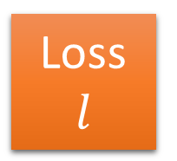
Loss
A good function should make the loss of all examples as small as possible.
“1”
……
y₁
1
As close as possible
……
y₂
Given a set of parameters
0
Softmax
……
……
……
……
……
Loss
$$l$$
……
y₁₀
0
Loss can be square error or cross entropy between the network output and target
target
Notes:
With softmax, the summation of all the ouputs would be one.
Can be considered as probability if you want ……

Slide 34
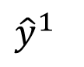
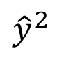
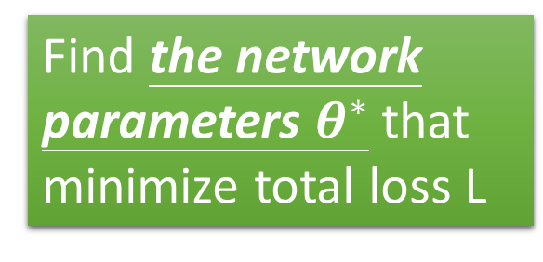
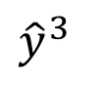
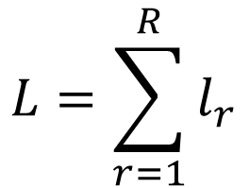
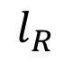
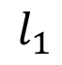
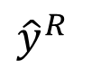
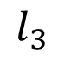
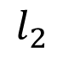
Total Loss
Total Loss:
$$L=\sum_{r=1}^{R}{l_{r}}$$
For all training data …
x¹
NN
y¹
$${\hat{y}}^{1}$$
$$l_{1}$$
As small as possible
x²
NN
y²
$${\hat{y}}^{2}$$
Find a function in function set that minimizes total loss L
$$l_{2}$$
x³
NN
y³
$${\hat{y}}^{3}$$
$$l_{3}$$
……
……
……
……
Find the network parameters $θ^{∗}$ that minimize total loss L
x^{R}
NN
y^{R}
$${\hat{y}}^{R}$$
$$l_{R}$$
Notes:
Randomly picked one
Two approaches update the parameters towards the same direction, but stochastic is faster!
Better!

Slide 35
Three Steps for Deep Learning
Step 1: define a set of function
Step 2: goodness of function
Step 3: pick the best function

Slide 36


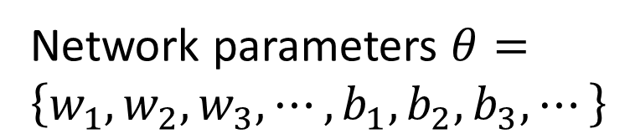
How to pick the best function
Find network parameters $θ^{∗}$ that minimize total loss L
Layer l
Layer l+1
Enumerate all possible values
Network parameters $θ=\left\{w_{1},w_{2},w_{3},⋯,b_{1},b_{2},b_{3},⋯\right\}$
10⁶
weights
……
……
Millions of parameters
E.g. speech recognition: 8 layers and 1000 neurons each layer
1000
neurons
1000
neurons
Notes:
百萬等級的
Solving this optimization problem by Calculus or something

Slide 37
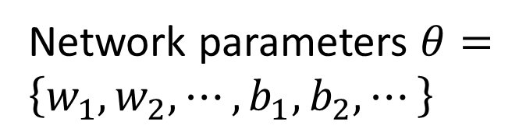
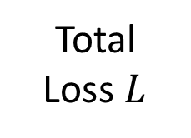
Gradient Descent
Network parameters $θ=\left\{w_{1},w_{2},⋯,b_{1},b_{2},⋯\right\}$
Find network parameters $θ^{∗}$ that minimize total loss L
Pick an initial value for w
Total
Loss $L$
Random, RBM pre-train
Usually good enough
Notes:
Consider a parameter w in $θ$

Slide 38
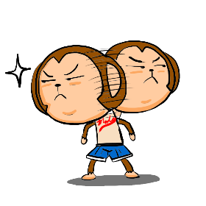
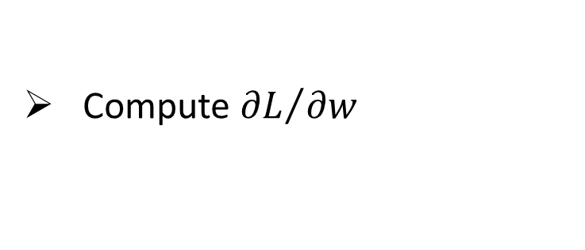
Gradient Descent
Network parameters $θ=\left\{w_{1},w_{2},⋯,b_{1},b_{2},⋯\right\}$
Find network parameters $θ^{∗}$ that minimize total loss L
Pick an initial value for w
Total
Loss $L$
Compute ${∂L}/{∂w}$
Negative
Increase w
Positive
Decrease w
http://chico386.pixnet.net/album/photo/171572850
Notes:
Consider a parameter w in $θ$
切線斜率

Slide 39
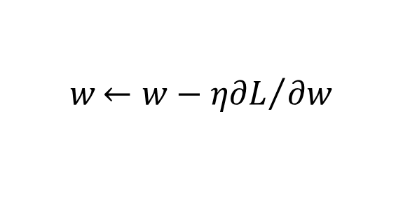
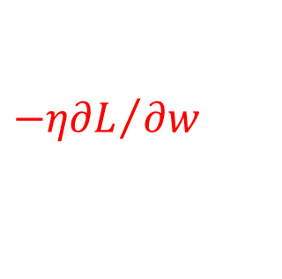
Gradient Descent
Network parameters $θ=\left\{w_{1},w_{2},⋯,b_{1},b_{2},⋯\right\}$
Find network parameters $θ^{∗}$ that minimize total loss L
Pick an initial value for w
Total
Loss $L$
Compute ${∂L}/{∂w}$
$$w{←w−η∂L}/{∂w}$$
Repeat
η is called “learning rate”
$${−η∂L}/{∂w}$$
Notes:
eta
Consider a parameter w in $θ$

Slide 40
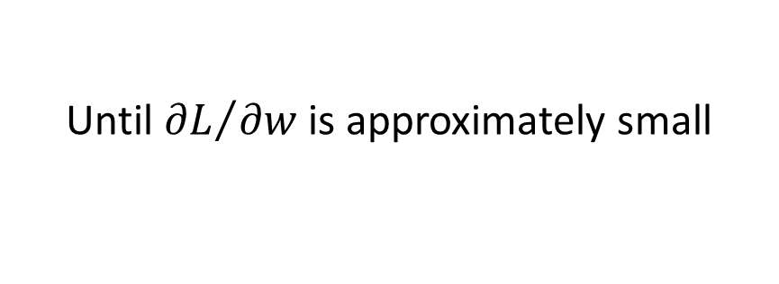
Gradient Descent
Network parameters $θ=\left\{w_{1},w_{2},⋯,b_{1},b_{2},⋯\right\}$
Find network parameters $θ^{∗}$ that minimize total loss L
Pick an initial value for w
Total
Loss $L$
Compute ${∂L}/{∂w}$
$$w{←w−η∂L}/{∂w}$$
Repeat
Until ${∂L}/{∂w}$ is approximately small
(when update is little)
Notes:
Consider a parameter w in $θ$

Slide 41
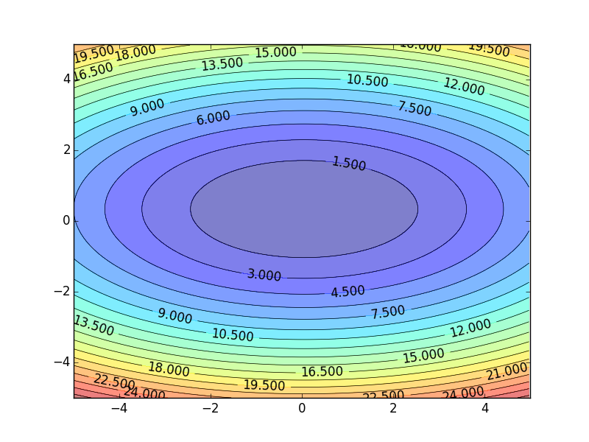
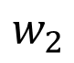
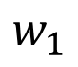
Gradient Descent
Color: Value of Total Loss L
$$w_{2}$$
Randomly pick a starting point
$$w_{1}$$
Notes:
A network can have millions of parameters.
Backpropagation is the way to compute the gradients efficiently (not today)
Ref: http://speech.ee.ntu.edu.tw/~tlkagk/courses/MLDS_2015_2/Lecture/DNN%20backprop.ecm.mp4/index.html

Slide 42
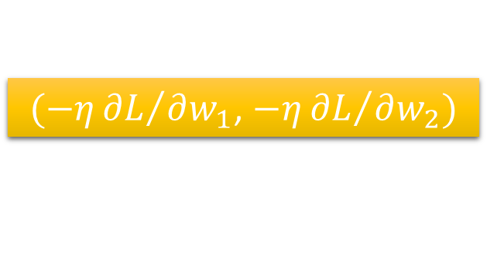
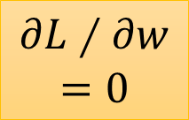
Gradient Descent
Hopfully, we would reach a minima …..
Color: Value of Total Loss L
$$w_{2}$$
$(−η{∂L}/{∂w_{1}}$, $−η{∂L}/{∂w_{2}})$
Compute ${∂L}/{∂w_{1}}$, ${∂L}/{∂w_{2}}$
$$w_{1}$$
Notes:
Questions: image you are playing AOC
A network can have millions of parameters.
Backpropagation is the way to compute the gradients efficiently (not today)
Ref: http://speech.ee.ntu.edu.tw/~tlkagk/courses/MLDS_2015_2/Lecture/DNN%20backprop.ecm.mp4/index.html

Slide 43
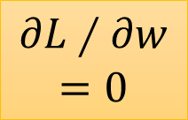

Local Minima
Total
Loss
Very slow at the plateau
Stuck at saddle point
Stuck at local minima
$$∂L∕∂w$$
$$≈0$$
$$∂L∕∂w$$
$$=0$$
$$∂L∕∂w$$
$$=0$$
The value of a network parameter w

Slide 44
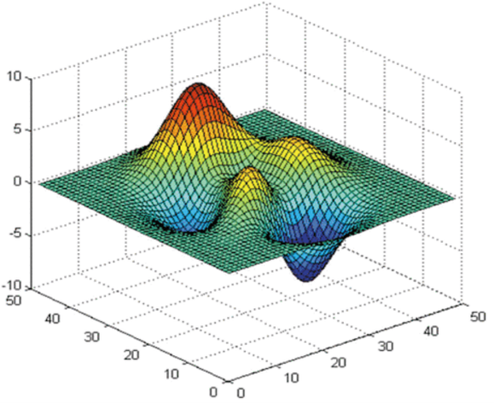



Local Minima
Gradient descent never guarantee global minima
Different initial point
$$L$$
Reach different minima, so different results
$$w_{1}$$
$$w_{2}$$
Notes:
看人品的方法
Who is Afraid of Non-Convex Loss Functions?
http://videolectures.net/eml07_lecun_wia/

Slide 45


Gradient Descent
This is the “learning” of machines in deep learning ……
Even alpha go using this approach.
People image ……
Actually …..
I hope you are not too disappointed :p

Slide 46









Backpropagation
Backpropagation: an efficient way to compute ${∂L}/{∂w}$ in neural network
libdnn
台大周伯威
同學開發
Ref: https://www.youtube.com/watch?v=ibJpTrp5mcE
Notes:
amazon-dsstne

Slide 47
Three Steps for Deep Learning
Step 1: define a set of function
Step 2: goodness of function
Step 3: pick the best function
Deep Learning is so simple ……
Now If you want to find a function
If you have lots of function input/output (?) as training data
You can use deep learning

Slide 48


For example, you can do …….
Image Recognition
“monkey”
“monkey”
Network
“cat”
“cat”
“dog”
“dog”

Slide 49


For example, you can do …….
“Talk” in e-mail
Spam
filtering
Network
1/0
(Yes/No)
“free” in e-mail
1 (Yes)
0 (No)
(http://spam-filter-review.toptenreviews.com/)
Notes:
Can we have more examples ….

Slide 50


For example, you can do …….
政治
“stock” in document
Network
經濟
體育
“president” in document
體育
政治
財經
http://top-breaking-news.com/

Slide 51
Outline
“Hello World” for Deep Learning
Introduction of Deep Learning
Tips for Deep Learning
Notes:
The three steps can also apply on other machine learning methods

Slide 52

Keras
If you want to learn theano:
http://speech.ee.ntu.edu.tw/~tlkagk/courses/MLDS_2015_2/Lecture/Theano%20DNN.ecm.mp4/index.html
http://speech.ee.ntu.edu.tw/~tlkagk/courses/MLDS_2015_2/Lecture/RNN%20training%20(v6).ecm.mp4/index.html
Very flexible
or
Need some effort to learn
Easy to learn and use
Interface of TensorFlow or Theano
(still have some flexibility)
You can modify it if you can write TensorFlow or Theano
keras

Slide 53
Keras
François Chollet is the author of Keras.
He currently works for Google as a deep learning engineer and researcher.
Keras means horn in Greek
Documentation: http://keras.io/
Example: https://github.com/fchollet/keras/tree/master/examples
Notes:
角；觸角，觸鬚牛角
而謹慎的佩涅洛佩則説道：“尊敬的客人，夢幻是很難解釋清楚的，并不是所有的夢景都會變爲現實。來去無蹤的夢神一般穿行於兩座大門，一座由牛角制成，一座由象牙雕成。穿過象牙大門來到人的夢鄉的夢神，只會欺人，所現所説不會成爲現實。而通過牛角大門進入的夢神，卻給任何一個凡人帶真實可信的訊息。但是，我的夢境不是後一位夢神提供的，雖然那里情節讓我心情舒暢。

Slide 54

使用 Keras 心得
感謝 沈昇勳 同學提供圖檔

Slide 55

Example Application
Handwriting Digit Recognition
Machine
“1”
28 x 28
MNIST Data: http://yann.lecun.com/exdb/mnist/
“Hello world” for deep learning
Keras provides data sets loading function: http://keras.io/datasets/

Slide 56




Keras
28x28
……
500
……
500
……
Softmax
y₁
y₂
y₁₀
……

Slide 57


Keras

Slide 58

Keras
Step 3.1: Configuration
$$w{←w−η∂L}/{∂w}$$
0.1
Step 3.2: Find the optimal network parameters
Training data
(Images)
Labels
(digits)

Slide 59


Keras
Step 3.2: Find the optimal network parameters
numpy array
numpy array
28 x 28
=784
……
10
……
Number of training examples
Number of training examples
https://www.tensorflow.org/versions/r0.8/tutorials/mnist/beginners/index.html

Slide 60



Keras
Save and load models
http://keras.io/getting-started/faq/#how-can-i-save-a-keras-model
How to use the neural network (testing):
case 1:
case 2:

Slide 61
Keras
Using GPU to speed training
Way 1
THEANO_FLAGS=device=gpu0 python YourCode.py
Way 2 (in your code)
import os
os.environ["THEANO_FLAGS"] = "device=gpu0"
Notes:
THEANO_FLAGS=device=gpu0 python YourCode.py
import os
os.environ["THEANO_FLAGS"] = "device=cpu"

Slide 62
Demo

Slide 63

Three Steps for Deep Learning
Step 1: define a set of function
Step 2: goodness of function
Step 3: pick the best function
Deep Learning is so simple ……

Slide 64
Outline
“Hello World” for Deep Learning
Introduction of Deep Learning
Tips for Deep Learning
Notes:
The three steps can also apply on other machine learning methods

Slide 65


Recipe of Deep Learning
YES
Step 1: define a set of function
Step 2: goodness of function
Step 3: pick the best function
NO
Good Results on Testing Data?
Overfitting!
YES
NO
Good Results on Training Data?
Neural Network
Notes:
Other methods do not emphasize this.

Slide 66


Do not always blame Overfitting
Not well trained
Overfitting?
Training Data
Testing Data
Deep Residual Learning for Image Recognition
http://arxiv.org/abs/1512.03385

Slide 67
Recipe of Deep Learning
YES
Good Results on Testing Data?
Different approaches for different problems.
YES
e.g. dropout for good results on testing data
Good Results on Training Data?
Neural Network

Slide 68
Recipe of Deep Learning
YES
Momentum
Adaptive Learning Rate
Choosing proper loss
New activation function
Mini-batch
Good Results on Testing Data?
YES
Good Results on Training Data?

Slide 69





Choosing Proper Loss
“1”
……
y₁
1
$${\hat{y}}_{1}$$
1
……
y₂
0
$${\hat{y}}_{2}$$
0
Softmax
……
……
……
……
……
……
loss
……
y₁₀
0
0
$${\hat{y}}_{10}$$
Which one is better?
target
$$\sum_{i=1}^{10}{{\left(y_{i}−\hat{y_{i}}\right)}^{2}}$$
$$−\sum_{i=1}^{10}{\hat{y_{i}}lny_{i}}$$
Square
Error
Cross Entropy
=0
=0

Slide 70


Demo
Square Error
Cross Entropy
Several alternatives: https://keras.io/objectives/

Slide 71
Demo

Slide 72

Choosing Proper Loss
When using softmax output layer, choose cross entropy
Cross Entropy
Total
Loss
Square
Error
http://jmlr.org/proceedings/papers/v9/glorot10a/glorot10a.pdf
w₁
w₂

Slide 73
Recipe of Deep Learning
YES
Momentum
Adaptive Learning Rate
Choosing proper loss
New activation function
Mini-batch
Good Results on Testing Data?
YES
Good Results on Training Data?

Slide 74
Mini-batch
We do not really minimize total loss!
Randomly initialize network parameters
x¹
NN
y¹
Pick the 1st batch
$${\hat{y}}^{1}$$
$$l^{1}$$
$$L′=l^{1}+l^{31}+⋯$$
Mini-batch
NN
x³¹
y³¹
$${\hat{y}}^{31}$$
Update parameters once
$$l^{31}$$
Pick the 2nd batch
……
$$L′′=l^{2}+l^{16}+⋯$$
Update parameters once
x²
NN
y²
$${\hat{y}}^{2}$$
$$l^{2}$$
…
Until all mini-batches have been picked
Mini-batch
x¹⁶
NN
y¹⁶
$${\hat{y}}^{16}$$
$$l^{16}$$
one epoch
……
Repeat the above process

Slide 75
Mini-batch
Pick the 1st batch
x¹
NN
y¹
$${\hat{y}}^{1}$$
$$L′=l^{1}+l^{31}+⋯$$
$$l^{1}$$
Mini-batch
NN
Update parameters once
x³¹
y³¹
$${\hat{y}}^{31}$$
$$l^{31}$$
Pick the 2nd batch
……
$$L′′=l^{2}+l^{16}+⋯$$
Update parameters once
100 examples in a mini-batch
…
Until all mini-batches have been picked
Repeat 20 times
one epoch

Slide 76


Mini-batch
Original Gradient Descent
With Mini-batch
Unstable!!!
The colors represent the total loss.
Notes:
Hopefully, when the match size is large enough,
Not that stateble

Slide 77


Mini-batch is Faster
Not always true with parallel computing.
Original Gradient Descent
With Mini-batch
Update after seeing all examples
If there are 20 batches, update 20 times in one epoch.
See all examples
See only one batch
Can have the same speed (not super large data set)
1 epoch
Mini-batch has better performance!

Slide 78
Demo

Slide 79


Shuffle the training examples for each epoch
Epoch 1
Epoch 2
x¹
NN
y¹
x¹
NN
y¹
$${\hat{y}}^{1}$$
$${\hat{y}}^{1}$$
$$l^{1}$$
$$l^{1}$$
Mini-batch
NN
Mini-batch
NN
x³¹
y³¹
$${\hat{y}}^{31}$$
x¹⁷
y¹⁷
$${\hat{y}}^{17}$$
$$l^{31}$$
$$l^{17}$$
……
……
Don’t worry. This is the default of Keras.
x²
NN
y²
x²
NN
y²
$${\hat{y}}^{2}$$
$${\hat{y}}^{2}$$
$$l^{2}$$
$$l^{2}$$
Mini-batch
NN
Mini-batch
NN
x¹⁶
y¹⁶
$${\hat{y}}^{16}$$
x²⁶
y²⁶
$${\hat{y}}^{26}$$
$$l^{16}$$
$$l^{26}$$
……
……

Slide 80
Recipe of Deep Learning
YES
Momentum
Adaptive Learning Rate
Choosing proper loss
New activation function
Mini-batch
Good Results on Testing Data?
YES
Good Results on Training Data?

Slide 81

Hard to get the power of Deep …
Results on Training Data
Deeper usually does not imply better.

Slide 82
Demo

Slide 83
Vanishing Gradient Problem
……
y₁
……
y₂
……
……
……
……
……
……
y_{M}
Smaller gradients
Larger gradients
Learn very slow
Learn very fast
Almost random
Already converge
based on random!?

Slide 84












Vanishing Gradient Problem
Smaller gradients
……
$$y_{1}$$
$${\hat{y}}_{1}$$
Small output
……
$$y_{2}$$
$${\hat{y}}_{2}$$
……
……
……
……
……
$$l$$
……
$$+∆l$$
……
$$y_{M}$$
$${\hat{y}}_{M}$$
Large input
$$+∆w$$
Intuitive way to compute the derivatives …
$$\frac{∂l}{∂w}=?$$
$$\frac{∆l}{∆w}$$

Slide 85
Hard to get the power of Deep …
In 2006, people used RBM pre-training.
In 2015, people use ReLU.

Slide 86





ReLU
Rectified Linear Unit (ReLU)
Reason:
$$a$$
$$σ\left(z\right)$$
1. Fast to compute
$$a=z$$
2. Biological reason
$$a=0$$
3. Infinite sigmoid with different biases
$$z$$
4. Vanishing gradient problem
[Xavier Glorot, AISTATS’11]
[Andrew L. Maas, ICML’13]
[Kaiming He, arXiv’15]
Notes:
Parametric ReLU, -> PReLU
Ref: Glorot, Xavier, Antoine Bordes, and Yoshua Bengio. "Deep sparse rectifier neural networks." International Conference on Artificial Intelligence and Statistics. 2011.

Slide 87
ReLU
$$a$$
$$a=z$$
$$a=0$$
$$z$$
0
0
0
0

Slide 88
ReLU
$$a$$
$$a=z$$
A Thinner linear network
$$a=0$$
$$z$$
Do not have smaller gradients

Slide 89
Demo

Slide 90




ReLU - variant
$$Leaky ReLU$$
$$Parametric ReLU$$
$$a$$
$$a$$
$$a=z$$
$$a=z$$
$$z$$
$$z$$
$$a=0.01z$$
$$a=αz$$
α also learned by gradient descent

Slide 91












Maxout
ReLU is a special cases of Maxout
Learnable activation function [Ian J. Goodfellow, ICML’13]
+
neuron
+
$$5$$
$$1$$
Input
Max
$$7$$
Max
$$2$$
+
$$7$$
+
$$2$$
+
$$−1$$
+
$$4$$
Max
$$1$$
Max
$$4$$
+
$$1$$
+
$$3$$
You can have more than 2 elements in a group.

Slide 92
Maxout
ReLU is a special cases of Maxout
Learnable activation function [Ian J. Goodfellow, ICML’13]
Activation function in maxout network can be any piecewise linear convex function
How many pieces depending on how many elements in a group
2 elements in a group
3 elements in a group
Notes:
3,4,5

Slide 93
Recipe of Deep Learning
YES
Momentum
Adaptive Learning Rate
Choosing proper loss
New activation function
Mini-batch
Good Results on Testing Data?
YES
Good Results on Training Data?

Slide 94

Learning Rates
Set the learning rate η carefully
If learning rate is too large
Total loss may not decrease after each update
$$w_{2}$$
$$w_{1}$$

Slide 95
Learning Rates
Set the learning rate η carefully
If learning rate is too large
Total loss may not decrease after each update
$$w_{2}$$
If learning rate is too small
Training would be too slow
$$w_{1}$$

Slide 96

Learning Rates
Popular & Simple Idea: Reduce the learning rate by some factor every few epochs.
At the beginning, we are far from the destination, so we use larger learning rate
After several epochs, we are close to the destination, so we reduce the learning rate
E.g. 1/t decay: $η^{t}=η/{\sqrt{t+1}}$
Learning rate cannot be one-size-fits-all
Giving different parameters different learning rates
Notes:
Advanced Idea: Eta
Can we give each parameters different learning rates?

Slide 97




Adagrad
Original:
$$w←w−η∂L∕∂w$$
Adagrad:
$$w←w−{\text{η}}_{w}∂L∕∂w$$
Parameter dependent learning rate
constant
$${\text{η}}_{w}=\frac{η}{\sqrt{\sum_{i=0}^{t}{{\left(g^{i}\right)}^{2}}}}$$
$g^{i}$ is $∂L∕∂w$ obtained at the i-th update
Summation of the square of the previous derivatives

Slide 98











Adagrad
$${\text{η}}_{w}=\frac{η}{\sqrt{\sum_{i=0}^{t}{{\left(g^{i}\right)}^{2}}}}$$
g⁰ | g¹ | ……
0.1 | 0.2 | ……
g⁰ | g¹ | ……
20.0 | 10.0 | ……
$$w_{1}$$
$$w_{2}$$
Learning rate:
Learning rate:
$$\frac{η}{\sqrt{{0.1}^{2}}}$$
$$=\frac{η}{0.1}$$
$$\frac{η}{\sqrt{{20}^{2}}}$$
$$=\frac{η}{20}$$
$$\frac{η}{\sqrt{{0.1}^{2}+{0.2}^{2}}}$$
$$=\frac{η}{0.22}$$
$$\frac{η}{\sqrt{{20}^{2}+{10}^{2}}}$$
$$=\frac{η}{22}$$
Observation:
1. Learning rate is smaller and smaller for all parameters
2. Smaller derivatives, larger learning rate, and vice versa
Why?
Notes:
反差
http://seed.ucsd.edu/mediawiki/images/6/6a/Adagrad.pdf
http://courses.cs.washington.edu/courses/cse547/15sp/slides/adagrad.pdf

Slide 99

Larger derivatives
Smaller Learning Rate
Smaller Derivatives
Larger Learning Rate
2. Smaller derivatives, larger learning rate, and vice versa
Why?

Slide 100
Not the whole story ……
Adagrad [John Duchi, JMLR’11]
RMSprop
https://www.youtube.com/watch?v=O3sxAc4hxZU
Adadelta [Matthew D. Zeiler, arXiv’12]
“No more pesky learning rates” [Tom Schaul, arXiv’12]
AdaSecant [Caglar Gulcehre, arXiv’14]
Adam [Diederik P. Kingma, ICLR’15]
Nadam
http://cs229.stanford.edu/proj2015/054_report.pdf

Slide 101
Recipe of Deep Learning
YES
Momentum
Adaptive Learning Rate
Choosing proper loss
New activation function
Mini-batch
Good Results on Testing Data?
YES
Good Results on Training Data?

Slide 102
Hard to find optimal network parameters
Total
Loss
Very slow at the plateau
Stuck at saddle point
Stuck at local minima
$$∂L∕∂w$$
$$≈0$$
$$∂L∕∂w$$
$$=0$$
$$∂L∕∂w$$
$$=0$$
The value of a network parameter w

Slide 103
In physical world ……
Momentum
How about put this phenomenon in gradient descent?
Notes:
Momentum: 動量

Slide 104

Momentum
Still not guarantee reaching global minima, but give some hope ……
cost
Movement =
Negative of 𝜕𝐿∕𝜕𝑤 + Momentum
Negative of $∂L∕∂w$
Momentum
Real Movement
𝜕𝐿∕𝜕𝑤 = 0
Notes:
What can we see?

Slide 105


Adam
RMSProp (Advanced Adagrad) + Momentum

Slide 106
Demo

Slide 107
Recipe of Deep Learning
YES
Dropout
Early Stopping
Regularization
Network Structure
Good Results on Testing Data?
YES
Good Results on Training Data?

Slide 108


Panacea for Overfitting
Have more training data
Create more training data (?)
Handwriting recognition:
Original Training Data:
Created Training Data:
Shift 15。
Notes:
In speech recognition:
add noise
warping

Slide 109
Recipe of Deep Learning
YES
Dropout
Early Stopping
Regularization
Network Structure
Good Results on Testing Data?
YES
Good Results on Training Data?

Slide 110
Dropout
Training:
Each time before updating the parameters
Each neuron has p% to dropout

Slide 111
Dropout
Training:
Thinner!
Each time before updating the parameters
Each neuron has p% to dropout
The structure of the network is changed.
Using the new network for training
For each mini-batch, we resample the dropout neurons

Slide 112

Dropout
Testing:
No dropout
If the dropout rate at training is p%, all the weights times 1-p%
Assume that the dropout rate is 50%.
If a weight $w=1$ by training, set $w=0.5$ for testing.

Slide 113


Dropout - Intuitive Reason
Testing
No dropout
(拿下重物後就變很強)
Training
Dropout (腳上綁重物)

Slide 114
















Dropout - Intuitive Reason
Why the weights should multiply (1-p)% (dropout rate) when testing?
Training of Dropout
Testing of Dropout
Assume dropout rate is 50%
No dropout
Weights from training
$$w_{1}$$
$$0.5×$$
$$w_{1}$$
$$z^{′}≈2z$$
$$w_{2}$$
$$z$$
$$0.5×$$
$$w_{2}$$
$$z^{′}$$
$$w_{3}$$
$$0.5×$$
$$w_{3}$$
$$w_{4}$$
$$0.5×$$
$$w_{4}$$
Weights multiply 1-p%
$$z^{′}≈z$$
Notes:
important

Slide 115
Dropout is a kind of ensemble.
Training Set
Ensemble
Set 1
Set 2
Set 3
Set 4
Network
1
Network
2
Network
3
Network
4
Train a bunch of networks with different structures

Slide 116
Dropout is a kind of ensemble.
Ensemble
Testing data x
Network
1
Network
2
Network
3
Network
4
y₁
y₂
y₃
y₄
average

Slide 117
Dropout is a kind of ensemble.
minibatch
1
minibatch
2
minibatch
3
minibatch
4
Training of Dropout
M neurons
……
2^{M} possible networks
Using one mini-batch to train one network
Some parameters in the network are shared

Slide 118
Dropout is a kind of ensemble.
Testing of Dropout
testing data x
All the weights multiply 1-p%
……
y₁
y₂
y₃
?????
average
≈
y
Notes:
0,0 -> 0
1,0 -> 1
0,-1 -> -2
1,-1 -> -1
½, -1/2 -> -0.5
1,2
Geometric Mean?

Slide 119
More about dropout
More reference for dropout [Nitish Srivastava, JMLR’14] [Pierre Baldi, NIPS’13][Geoffrey E. Hinton, arXiv’12]
Dropout works better with Maxout [Ian J. Goodfellow, ICML’13]
Dropconnect [Li Wan, ICML’13]
Dropout delete neurons
Dropconnect deletes the connection between neurons
Annealed dropout [S.J. Rennie, SLT’14]
Dropout rate decreases by epochs
Standout [J. Ba, NISP’13]
Each neural has different dropout rate

Slide 120
Demo
……
500
……
model.add( dropout(0.8) )
500
……
model.add( dropout(0.8) )
Softmax
y₁
y₂
y₁₀
……

Slide 121
Demo
Notes:
Rate = 0.5!

Slide 122
Recipe of Deep Learning
YES
Regularization
Dropout
Network Structure
Early Stopping
Good Results on Testing Data?
YES
Good Results on Training Data?
CNN is a very good example!
(next lecture)

Slide 123
Concluding Remarks

Slide 124
Recipe of Deep Learning
YES
Step 1: define a set of function
Step 2: goodness of function
Step 3: pick the best function
NO
Good Results on Testing Data?
YES
NO
Good Results on Training Data?
Neural Network
Notes:
Different techniques are used to deal with different problems.
不同方法間的互相搭配!!!!!!!!!!!!!!!!

Slide 125
Lecture II: Variants of Neural Networks

Slide 126
Variants of Neural Networks
Convolutional Neural Network (CNN)
Recurrent Neural Network (RNN)
Widely used in image processing

Slide 127










Why CNN for Image?
[Zeiler, M. D., ECCV 2014]
……
……
……
……
……
……
Represented as pixels
……
The most basic classifiers
Use 1st layer as module to build classifiers
Use 2nd layer as module ……
Can the network be simplified by considering the properties of images?

Slide 128


Why CNN for Image
Some patterns are much smaller than the whole image
A neuron does not have to see the whole image to discover the pattern.
Connecting to small region with less parameters
“beak” detector

Slide 129


Why CNN for Image
The same patterns appear in different regions.
“upper-left beak” detector
Do almost the same thing
They can use the same set of parameters.
“middle beak” detector

Slide 130


Why CNN for Image
Subsampling the pixels will not change the object
bird
bird
subsampling
We can subsample the pixels to make image smaller
Less parameters for the network to process the image

Slide 131
Three Steps for Deep Learning
Step 1: define a set of function
Step 2: goodness of function
Step 3: pick the best function
Convolutional
Neural Network
Deep Learning is so simple ……

Slide 132
The whole CNN
cat dog ……
Convolution
Max Pooling
Can repeat many times
Fully Connected Feedforward network
Convolution
Max Pooling
Flatten

Slide 133
The whole CNN
Property 1
Some patterns are much smaller than the whole image
Convolution
Property 2
Max Pooling
The same patterns appear in different regions.
Can repeat many times
Property 3
Convolution
Subsampling the pixels will not change the object
Max Pooling
Flatten

Slide 134
The whole CNN
cat dog ……
Convolution
Max Pooling
Can repeat many times
Fully Connected Feedforward network
Convolution
Max Pooling
Flatten

Slide 135
CNN – Convolution
Those are the network parameters to be learned.
1 | -1 | -1
-1 | 1 | -1
-1 | -1 | 1
1 | 0 | 0 | 0 | 0 | 1
0 | 1 | 0 | 0 | 1 | 0
0 | 0 | 1 | 1 | 0 | 0
1 | 0 | 0 | 0 | 1 | 0
0 | 1 | 0 | 0 | 1 | 0
0 | 0 | 1 | 0 | 1 | 0
Filter 1
Matrix
-1 | 1 | -1
-1 | 1 | -1
-1 | 1 | -1
Filter 2
Matrix
……
6 x 6 image
Each filter detects a small pattern (3 x 3).
Property 1

Slide 136
CNN – Convolution
1 | -1 | -1
-1 | 1 | -1
-1 | -1 | 1
Filter 1
stride=1
1 | 0 | 0 | 0 | 0 | 1
0 | 1 | 0 | 0 | 1 | 0
0 | 0 | 1 | 1 | 0 | 0
1 | 0 | 0 | 0 | 1 | 0
0 | 1 | 0 | 0 | 1 | 0
0 | 0 | 1 | 0 | 1 | 0
3
-1
6 x 6 image

Slide 137
CNN – Convolution
1 | -1 | -1
-1 | 1 | -1
-1 | -1 | 1
Filter 1
If stride=2
1 | 0 | 0 | 0 | 0 | 1
0 | 1 | 0 | 0 | 1 | 0
0 | 0 | 1 | 1 | 0 | 0
1 | 0 | 0 | 0 | 1 | 0
0 | 1 | 0 | 0 | 1 | 0
0 | 0 | 1 | 0 | 1 | 0
3
-3
We set stride=1 below
6 x 6 image

Slide 138
CNN – Convolution
1 | -1 | -1
-1 | 1 | -1
-1 | -1 | 1
Filter 1
stride=1
1 | 0 | 0 | 0 | 0 | 1
0 | 1 | 0 | 0 | 1 | 0
0 | 0 | 1 | 1 | 0 | 0
1 | 0 | 0 | 0 | 1 | 0
0 | 1 | 0 | 0 | 1 | 0
0 | 0 | 1 | 0 | 1 | 0
3
-1
-3
-1
-3
1
0
-3
-3
-3
0
1
3
-2
-2
-1
6 x 6 image
Property 2

Slide 139
CNN – Convolution
-1 | 1 | -1
-1 | 1 | -1
-1 | 1 | -1
Filter 2
stride=1
Do the same process for every filter
1 | 0 | 0 | 0 | 0 | 1
0 | 1 | 0 | 0 | 1 | 0
0 | 0 | 1 | 1 | 0 | 0
1 | 0 | 0 | 0 | 1 | 0
0 | 1 | 0 | 0 | 1 | 0
0 | 0 | 1 | 0 | 1 | 0
3
-1
-3
-1
-1
-1
-1
-1
-3
1
0
-3
-1
-1
-2
1
Feature
Map
-3
-3
0
1
-1
-1
-2
1
3
-2
-2
-1
6 x 6 image
-1
0
-4
3
4 x 4 image

Slide 140
CNN – Zero Padding
1 | -1 | -1
-1 | 1 | -1
-1 | -1 | 1
Filter 1
0
0
0
0
1 | 0 | 0 | 0 | 0 | 1
0 | 1 | 0 | 0 | 1 | 0
0 | 0 | 1 | 1 | 0 | 0
1 | 0 | 0 | 0 | 1 | 0
0 | 1 | 0 | 0 | 1 | 0
0 | 0 | 1 | 0 | 1 | 0
0
You will get another 6 x 6 images in this way
0
0
Zero padding
0
0
0
6 x 6 image

Slide 141

CNN – Colorful image
1 | -1 | -1
-1 | 1 | -1
-1 | -1 | 1
-1 | 1 | -1
-1 | 1 | -1
-1 | 1 | -1
1 | -1 | -1
-1 | 1 | -1
-1 | -1 | 1
-1 | 1 | -1
-1 | 1 | -1
-1 | 1 | -1
1 | -1 | -1
-1 | 1 | -1
-1 | -1 | 1
-1 | 1 | -1
-1 | 1 | -1
-1 | 1 | -1
Filter 1
Filter 2
Colorful image
1 | 0 | 0 | 0 | 0 | 1
0 | 1 | 0 | 0 | 1 | 0
0 | 0 | 1 | 1 | 0 | 0
1 | 0 | 0 | 0 | 1 | 0
0 | 1 | 0 | 0 | 1 | 0
0 | 0 | 1 | 0 | 1 | 0
1 | 0 | 0 | 0 | 0 | 1
0 | 1 | 0 | 0 | 1 | 0
0 | 0 | 1 | 1 | 0 | 0
1 | 0 | 0 | 0 | 1 | 0
0 | 1 | 0 | 0 | 1 | 0
0 | 0 | 1 | 0 | 1 | 0
1 | 0 | 0 | 0 | 0 | 1
0 | 1 | 0 | 0 | 1 | 0
0 | 0 | 1 | 1 | 0 | 0
1 | 0 | 0 | 0 | 1 | 0
0 | 1 | 0 | 0 | 1 | 0
0 | 0 | 1 | 0 | 1 | 0

Slide 142

Convolution v.s. Fully Connected
1 | 0 | 0 | 0 | 0 | 1
0 | 1 | 0 | 0 | 1 | 0
0 | 0 | 1 | 1 | 0 | 0
1 | 0 | 0 | 0 | 1 | 0
0 | 1 | 0 | 0 | 1 | 0
0 | 0 | 1 | 0 | 1 | 0
1 | -1 | -1
-1 | 1 | -1
-1 | -1 | 1
-1 | 1 | -1
-1 | 1 | -1
-1 | 1 | -1
convolution
image
1 | 0 | 0 | 0 | 0 | 1
0 | 1 | 0 | 0 | 1 | 0
0 | 0 | 1 | 1 | 0 | 0
1 | 0 | 0 | 0 | 1 | 0
0 | 1 | 0 | 0 | 1 | 0
0 | 0 | 1 | 0 | 1 | 0
Fully-connected
……
……

Slide 143

1 | -1 | -1
-1 | 1 | -1
-1 | -1 | 1
1:
1
Filter 1
2:
0
3:
0
3
4:
0
1 | 0 | 0 | 0 | 0 | 1
0 | 1 | 0 | 0 | 1 | 0
0 | 0 | 1 | 1 | 0 | 0
1 | 0 | 0 | 0 | 1 | 0
0 | 1 | 0 | 0 | 1 | 0
0 | 0 | 1 | 0 | 1 | 0
…
7:
0
8:
1
9:
0
10:
0
…
13:
0
6 x 6 image
14:
0
Less parameters!
15:
Only connect to 9 input, not fully connected
1
16:
1
…

Slide 144

1 | -1 | -1
-1 | 1 | -1
-1 | -1 | 1
1:
1
Filter 1
2:
0
3:
0
3
4:
0
1 | 0 | 0 | 0 | 0 | 1
0 | 1 | 0 | 0 | 1 | 0
0 | 0 | 1 | 1 | 0 | 0
1 | 0 | 0 | 0 | 1 | 0
0 | 1 | 0 | 0 | 1 | 0
0 | 0 | 1 | 0 | 1 | 0
…
7:
0
8:
1
-1
9:
0
10:
0
…
13:
0
6 x 6 image
14:
0
Less parameters!
15:
1
16:
1
Shared weights
Even less parameters!
…

Slide 145
The whole CNN
cat dog ……
Convolution
Max Pooling
Can repeat many times
Fully Connected Feedforward network
Convolution
Max Pooling
Flatten

Slide 146
CNN – Max Pooling
1 | -1 | -1
-1 | 1 | -1
-1 | -1 | 1
-1 | 1 | -1
-1 | 1 | -1
-1 | 1 | -1
Filter 1
Filter 2
3
-1
-3
-1
-1
-1
-1
-1
-3
1
0
-3
-1
-1
-2
1
-3
-3
0
1
-1
-1
-2
1
3
-2
-2
-1
-1
0
-4
3

Slide 147
CNN – Max Pooling
New image
but smaller
1 | 0 | 0 | 0 | 0 | 1
0 | 1 | 0 | 0 | 1 | 0
0 | 0 | 1 | 1 | 0 | 0
1 | 0 | 0 | 0 | 1 | 0
0 | 1 | 0 | 0 | 1 | 0
0 | 0 | 1 | 0 | 1 | 0
Conv
3
0
-1
1
Max
Pooling
3
1
0
3
2 x 2 image
6 x 6 image
Each filter
is a channel

Slide 148
The whole CNN
3
0
-1
1
Convolution
3
1
0
3
Max Pooling
Can repeat many times
A new image
Convolution
Smaller than the original image
The number of the channel is the number of filters
Max Pooling

Slide 149
The whole CNN
cat dog ……
Convolution
Max Pooling
A new image
Fully Connected Feedforward network
Convolution
Max Pooling
A new image
Flatten

Slide 150
Flatten
3
0
1
3
0
-1
1
3
3
1
-1
0
3
Flatten
1
Fully Connected Feedforward network
0
3

Slide 151
Convolutional Neural Network
Step 1: define a set of function
Step 2: goodness of function
Step 3: pick the best function
Convolutional
Neural Network
“monkey”
0
CNN
“cat”
1
……
“dog”
0
Convolution, Max Pooling, fully connected
target
Learning: Nothing special, just gradient descent ……

Slide 152

CNN in Keras
Only modified the network structure and input format (vector -> 3-D tensor)
input
Convolution
1 | -1 | -1
-1 | 1 | -1
-1 | -1 | 1
-1 | 1 | -1
-1 | 1 | -1
-1 | 1 | -1
There are 25 3x3 filters.
……
Max Pooling
Input_shape = ( 1 , 28 , 28 )
1: black/weight, 3: RGB
28 x 28 pixels
Convolution
3
-1
3
Max Pooling
-3
1

Slide 153
CNN in Keras
Only modified the network structure and input format (vector -> 3-D tensor)
input
1 x 28 x 28
Convolution
How many parameters for each filter?
9
25 x 26 x 26
Max Pooling
25 x 13 x 13
Convolution
How many parameters for each filter?
225
50 x 11 x 11
Max Pooling
50 x 5 x 5

Slide 154

CNN in Keras
Only modified the network structure and input format (vector -> 3-D tensor)
input
1 x 28 x 28
output
Convolution
25 x 26 x 26
Fully Connected Feedforward network
Max Pooling
25 x 13 x 13
Convolution
50 x 11 x 11
Max Pooling
1250
50 x 5 x 5
Flatten

Slide 155
Live Demo

Slide 156



What does CNN learn?
The output of the k-th filter is a 11 x 11 matrix.
x
input
Degree of the activation of the k-th filter:
$$a^{k}=\sum_{i=1}^{11}{\sum_{j=1}^{11}{a_{ij}^{k}}}$$
25 3x3 filters
Convolution
$$x^{∗}=arg\max_{x}{a^{k}}$$
(gradient ascent)
11
Max Pooling
3
-1
……
-1
50 3x3 filters
$$a_{ij}^{k}$$
Convolution
-3
1
……
-3
11
50 x 11 x 11
……
……
……
Max Pooling
3
-2
……
-1

Slide 157

What does CNN learn?
The output of the k-th filter is a 11 x 11 matrix.
input
Degree of the activation of the k-th filter:
$$a^{k}=\sum_{i=1}^{11}{\sum_{j=1}^{11}{a_{ij}^{k}}}$$
25 3x3 filters
Convolution
$$x^{∗}=arg\max_{x}{a^{k}}$$
(gradient ascent)
Max Pooling
50 3x3 filters
Convolution
50 x 11 x 11
Max Pooling
For each filter

Slide 158




What does CNN learn?
input
$$x^{∗}=arg\max_{x}{y^{i}}$$
Can we see digits?
Convolution
Max Pooling
0
1
2
Convolution
Max Pooling
3
4
5
flatten
6
7
8
Deep Neural Networks are Easily Fooled
https://www.youtube.com/watch?v=M2IebCN9Ht4
$$y_{i}$$

Slide 159



What does CNN learn?
Over all pixel values
$$x^{∗}=arg\max_{x}\left(y^{i}+\sum_{i,j}{\left|x_{ij}\right|}\right)$$
$$x^{∗}=arg\max_{x}{y^{i}}$$
0
1
2
0
1
2
3
4
5
3
4
5
6
7
8
6
7
8

Slide 160



Deep Dream
CNN
Modify image
Given a photo, machine adds what it sees ……
$$\left[\begin{aligned}3.9 \\ −1.5 \\ 2.3 \\ ⋮\end{aligned}\right]$$
CNN exaggerates what it sees
http://deepdreamgenerator.com/

Slide 161

Deep Dream
Given a photo, machine adds what it sees ……
http://deepdreamgenerator.com/

Slide 162

Deep Style
Given a photo, make its style like famous paintings
https://dreamscopeapp.com/

Slide 163

Deep Style
Given a photo, make its style like famous paintings
https://dreamscopeapp.com/

Slide 164

Deep Style
CNN
CNN
A Neural Algorithm of Artistic Style
https://arxiv.org/abs/1508.06576
content
style
CNN
?

Slide 165

More Application: Playing Go
Network
Next move
(19 x 19 positions)
19 x 19 matrix (image)
19 x 19 vector
19 x 19 vector
Fully-connected feedforward network can be used
Black: 1
white: -1
none: 0
But CNN performs much better.

Slide 166


More Application: Playing Go
record of previous plays
Training:
黑: 5之五
白: 天元
黑: 五之5 …
Target:
“天元” = 1
else = 0
CNN
Target:
“五之 5” = 1
else = 0
CNN

Slide 167


Why CNN for playing Go?
Some patterns are much smaller than the whole image
The same patterns appear in different regions.
Alpha Go uses 5 x 5 for first layer

Slide 168

Why CNN for playing Go?
Subsampling the pixels will not change the object
Max Pooling
How to explain this???
Alpha Go does not use Max Pooling ……
Notes:
CNN is widely used
Very good example for designing your network

Slide 169
Variants of Neural Networks
Convolutional Neural Network (CNN)
Recurrent Neural Network (RNN)
Neural Network with Memory

Slide 170

Example Application
Slot Filling
I would like to arrive Taipei on November 2nd.
ticket booking system
Destination:
Taipei
Slot
time of arrival:
November 2nd
Notes:
https://catalog.ldc.upenn.edu/docs/LDC93S4B/corpus.html

Slide 171
Example Application
Solving slot filling by Feedforward network?
Input: a word
(Each word is represented as a vector)
Taipei

Slide 172
1-of-N encoding
How to represent each word as a vector?
1-of-N Encoding
lexicon = {apple, bag, cat, dog, elephant}
The vector is lexicon size.
apple = [ 1 0 0 0 0]
bag = [ 0 1 0 0 0]
Each dimension corresponds to a word in the lexicon
cat = [ 0 0 1 0 0]
The dimension for the word is 1, and others are 0
dog = [ 0 0 0 1 0]
elephant = [ 0 0 0 0 1]
Notes:
Can be very large

Slide 173
Beyond 1-of-N encoding
Dimension for “Other”
Word hashing
apple
0
a-a-a
0
bag
0
a-a-b
0
…
…
cat
0
a-p-p
1
dog
0
…
…
…
26 X 26 X 26
elephant
0
p-l-e
1
…
…
p-p-l
1
“other”
1
…
…
w = “apple”
w = “Gandalf”
w = “Sauron”

Slide 174
Example Application
time of departure
dest
Solving slot filling by Feedforward network?
Input: a word
(Each word is represented as a vector)
Output:
Probability distribution that the input word belonging to the slots
Taipei

Slide 175
Example Application
time of departure
dest
arrive Taipei on November 2nd
other
dest
other
time
time
Problem?
leave Taipei on November 2nd
place of departure
Neural network needs memory!
Taipei

Slide 176
Three Steps for Deep Learning
Step 1: define a set of function
Step 2: goodness of function
Step 3: pick the best function
Recurrent Neural Network
Deep Learning is so simple ……

Slide 177
Recurrent Neural Network (RNN)
The output of hidden layer are stored in the memory.
store
Memory can be considered as another input.

Slide 178
RNN
The same network is used again and again.
Probability of “arrive” in each slot
Probability of “Taipei” in each slot
Probability of “on” in each slot
y¹
y²
y³
store
store
a¹
a²
a³
a¹
a²
x¹
x²
x³
arrive Taipei on November 2nd
Notes:
General idea

Slide 179
RNN
Different
Prob of “leave” in each slot
Prob of “Taipei” in each slot
Prob of “arrive” in each slot
Prob of “Taipei” in each slot
y²
……
y²
……
y¹
y¹
store
store
a¹
a²
a¹
a²
a¹
……
a¹
……
x¹
x²
……
x¹
x²
……
leave
Taipei
arrive
Taipei
The values stored in the memory is different.
Notes:
Output y^{i} depends on x¹, x², …… x^{i}
The same input can have totoally different output.

Slide 180
Of course it can be deep …
y^{t}
y^{t+1}
y^{t+2}
……
……
……
……
……
……
……
……
……
x^{t}
x^{t+1}
x^{t+2}

Slide 181
Bidirectional RNN
……
x^{t}
x^{t+1}
x^{t+2}
……
y^{t}
y^{t+1}
y^{t+2}
……
……
x^{t}
x^{t+1}
x^{t+2}
Notes:
To determine yi, you have to consider a lot ……
You should see the whole sequence

Slide 182
Long Short-term Memory (LSTM)
Other part of the network
Special Neuron:
4 inputs,
1 output
Signal control the output gate
Output Gate
(Other part of the network)
Memory
Cell
Forget Gate
Signal control the forget gate
(Other part of the network)
Signal control the input gate
Input Gate
LSTM
(Other part of the network)
Other part of the network
Notes:
Normal neuron
1 input, 1 output
This one
4 input, 1 output

Slide 183

$$a$$
$$=h\left(c^{′}\right)f\left(z_{o}\right)$$
$$z_{o}$$
multiply
Activation function f is usually a sigmoid function
$$f\left(z_{o}\right)$$
$$h\left(c^{′}\right)$$
Between 0 and 1
Mimic open and close gate
$$c$$
$$f\left(z_{f}\right)$$
c
$$c^{′}$$
$$z_{f}$$
$$cf\left(z_{f}\right)$$
$$c^{′}=g\left(z\right)f\left(z_{i}\right)+cf\left(z_{f}\right)$$
$$f\left(z_{i}\right)$$
$$g\left(z\right)f\left(z_{i}\right)$$
$$z_{i}$$
multiply
$$g\left(z\right)$$
$$z$$

Slide 184
0
≈0
-10
10
10
10
7
≈1
≈1
3
10
3
3

Slide 185
-3
≈1
10
-3
10
-3
-10
7
≈0
≈1
-3
10
-3
-3

Slide 186
LSTM
c^{t-1}
……
vector
z^{f}
z^{i}
z
zº
4 vectors
x^{t}
Notes:
Identiy
C is vector

Slide 187

LSTM
y^{t}
zº
c^{t-1}
$$×$$
$$＋$$
$$×$$
z^{f}
$$×$$
z^{i}
z^{f}
z^{i}
z
zº
x^{t}
z
Notes:
Identiy
C is vector

Slide 188
LSTM
Extension: “peephole”
y^{t}
y^{t+1}
c^{t-1}
c^{t}
c^{t+1}
$$×$$
$$＋$$
$$×$$
$$×$$
$$＋$$
$$×$$
$$×$$
$$×$$
z^{f}
z^{i}
z
zº
z^{f}
z^{i}
z
zº
c^{t-1}
h^{t-1}
x^{t}
c^{t}
h^{t}
x^{t+1}
Notes:
Identiy
C is vector

Slide 189


Multiple-layer
LSTM
Don’t worry if you cannot understand this. Keras can handle it.
Keras supports
“LSTM”, “GRU”, “SimpleRNN” layers
This is quite standard now.
https://img.komicolle.org/2015-09-20/src/14426967627131.gif
Notes:
Usually when people say RNN, they mean LSTM!

Slide 190
Three Steps for Deep Learning
Step 1: define a set of function
Step 2: goodness of function
Step 3: pick the best function
Deep Learning is so simple ……

Slide 191
Learning Target
other
dest
other
0
…
1
…
0
…
…
…
…
0
1
0
0
1
0
y¹
y²
y³
copy
copy
a¹
a²
a³
a¹
a²
W^{i}
x¹
x²
x³
Training
Sentences:
arrive Taipei on November 2nd
other
dest
other
time
time
Notes:
General idea

Slide 192
Three Steps for Deep Learning
Step 1: define a set of function
Step 2: goodness of function
Step 3: pick the best function
Deep Learning is so simple ……

Slide 193


Learning
Backpropagation through time (BPTT)
copy
$$w$$
$$w←w−η∂L∕∂w$$
RNN Learning is very difficult in practice.

Slide 194

Unfortunately ……
感謝 曾柏翔 同學
提供實驗結果
RNN-based network is not always easy to learn
Real experiments on Language modeling
sometimes
Total Loss
Lucky
Epoch
Notes:
Not because you have bug haha

Slide 195


The error surface is rough.
The error surface is either very flat or very steep.
Clipping
Cost
Total Loss
w₂
w₁
[Razvan Pascanu, ICML’13]
Notes:
Even adagrad can not handle this problem, maybe RMS prop is better
Source: http://jmlr.org/proceedings/papers/v28/pascanu13.pdf
Large or small is fine. Change quickly is bad

Slide 196










Why?
$$w=1$$
$$y^{1000}=1$$
Large
$${∂L}/{∂w}$$
Small Learning rate?
$$w=1.01$$
$$y^{1000}≈20000$$
$$w=0.99$$
$$y^{1000}≈0$$
small ${∂L}/{∂w}$
Large Learning rate?
$$w=0.01$$
$$y^{1000}≈0$$
=w⁹⁹⁹
y¹
y²
y³
y¹⁰⁰⁰
Toy Example
1
1
1
1
……
w
w
w
1
1
1
1
1
0
0
0
Notes:
Gradient Explode/Gradient Vanishing
Echo state network -> …..

Slide 197
Helpful Techniques
Long Short-term Memory (LSTM)
Can deal with gradient vanishing (not gradient explode)
Memory and input are added
The influence never disappears unless forget gate is closed
No Gradient vanishing
add
(If forget gate is opened.)
Gated Recurrent Unit (GRU):
simpler than LSTM
[Cho, EMNLP’14]

Slide 198


Helpful Techniques
Structurally Constrained Recurrent Network (SCRN)
Clockwise RNN
[Jan Koutnik, JMLR’14]
[Tomas Mikolov, ICLR’15]
Vanilla RNN Initialized with Identity matrix + ReLU activation function [Quoc V. Le, arXiv’15]
Outperform or be comparable with LSTM in 4 different tasks

Slide 199
More Applications ……
Probability of “arrive” in each slot
Probability of “Taipei” in each slot
Probability of “on” in each slot
y¹
y²
y³
Input and output are both sequences with the same length
store
store
a¹
a²
a³
a¹
a²
RNN can do more than that!
x¹
x²
x³
arrive Taipei on November 2nd

Slide 200
Many to one
Input is a vector sequence, but output is only one vector
Sentiment Analysis
超好雷
好雷
看了這部電影覺得很高興 …….
這部電影太糟了
…….
這部電影很棒 …….
普雷
負雷
Positive (正雷)
Negative (負雷)
Positive (正雷)
超負雷
……
我
覺
得
……
太
糟
了

Slide 201
Many to one
[Shen & Lee, Interspeech 16]
Input is a vector sequence, but output is only one vector
O_{T}
Key Term
Extraction
…
Key Terms:
DNN, LSTN
V₁
V₂
V₃
V₄
…
V_{T}
Output Layer
document
Embedding Layer
x₁
x₂
x₃
x₄
…
x_{T}
Hidden Layer
Embedding Layer
V₁
V₂
V₃
V₄
V_{T}
Σα_{i}V_{i}
…
α₁ α₂ α₃ α₄ … α_{T}

Slide 202

Many to Many (Output is shorter)
Both input and output are both sequences, but the output is shorter.
E.g. Speech Recognition
Output:
“好棒”
(character sequence)
Problem?
Trimming
Why can’t it be “好棒棒”
好
好
好
棒
棒
棒
棒
棒
(vector
sequence)
Input:

Slide 203
Many to Many (Output is shorter)
Both input and output are both sequences, but the output is shorter.
Connectionist Temporal Classification (CTC) [Alex Graves, ICML’06][Alex Graves, ICML’14][Haşim Sak, Interspeech’15][Jie Li, Interspeech’15][Andrew Senior, ASRU’15]
“好棒”
Add an extra symbol “φ” representing “null”
“好棒棒”
好
φ
φ
棒
φ
φ
φ
φ
好
φ
φ
棒
φ
棒
φ
φ
Notes:
English is successful, ASRU’15 better than HMM + N-gram

Slide 204
Many to Many (No Limitation)
Both input and output are both sequences with different lengths. → Sequence to sequence learning
E.g. Machine Translation (machine learning→機器學習)
Containing all information about input sequence
machine
learning
Notes:
中翻英 英翻中 沒有哪一個一定比較長或比較短

Slide 205
Many to Many (No Limitation)
Both input and output are both sequences with different lengths. → Sequence to sequence learning
E.g. Machine Translation (machine learning→機器學習)
機
器
學
習
慣
性
……
……
machine
learning
Don’t know when to stop
Notes:
中翻英 英翻中 沒有哪一個一定比較長或比較短

Slide 206

Many to Many (No Limitation)
推 tlkagk: =========斷==========
Ref:http://zh.pttpedia.wikia.com/wiki/%E6%8E%A5%E9%BE%8D%E6%8E%A8%E6%96%87 (鄉民百科)
Notes:
推文接龍

Slide 207
Many to Many (No Limitation)
Both input and output are both sequences with different lengths. → Sequence to sequence learning
E.g. Machine Translation (machine learning→機器學習)
機
器
學
習
===
machine
learning
Add a symbol “===“ (斷)
[Ilya Sutskever, NIPS’14][Dzmitry Bahdanau, arXiv’15]
Notes:
中翻英 英翻中 沒有哪一個一定比較長或比較短
More applications

Slide 208

Image Caption Generation
Input an image, but output a sequence of words
[Kelvin Xu, arXiv’15][Li Yao, ICCV’15]
A vector for whole image
a
woman
is
===
CNN
……
Input image
Caption Generation
Notes:
A woman is throwing a Frisbee in a part.

Slide 209
Image Caption Generation
Can machine describe what it see from image?
Demo:台大電機系 大四 蘇子睿、林奕辰、徐翊祥、陳奕安
MTK 產學大聯盟

Slide 210

http://news.ltn.com.tw/photo/politics/breakingnews/975542_1

Slide 211






Video Caption Generation
A girl is running.
Video
A group of people is knocked by a tree.
A group of people is walking in the forest.

Slide 212
Video Caption Generation
Can machine describe what it see from video?
Demo: 台大語音處理實驗室 曾柏翔、吳柏瑜、盧宏宗

Slide 213

Chat-bot
電視影集 (~40,000 sentences)、美國總統大選辯論
Notes:
Will you build a wall?

Slide 214

Demo
Develop Team
Interface design: Prof. Lin-Lin Chen & Arron Lu
Web programming: Shi-Yun Huang
Data collection: Chao-Chuang Shih
System implementation: Kevin Wu, Derek Chuang, & Zhi-Wei Lee
System design: Richard Tsai & Hung-Yi Lee
Notes:
What do you think of Global Warming? Will you build a wall Do you like machine learning?

Slide 215

Attention-based Model
What you learned in these lectures
Breakfast today
What is deep learning?
summer vacation 10 years ago
Organize
Answer
http://henrylo1605.blogspot.tw/2015/05/blog-post_56.html

Slide 216
Attention-based Model
Input
DNN/RNN
output
Reading Head Controller
Reading Head
……
……
Machine’s Memory
Ref: http://speech.ee.ntu.edu.tw/~tlkagk/courses/MLDS_2015_2/Lecture/Attain%20(v3).ecm.mp4/index.html
Notes:
Need an example …… ok, in the future

Slide 217
Attention-based Model v2
Input
DNN/RNN
output
Reading Head Controller
Writing Head Controller
Writing Head
Reading Head
……
……
Machine’s Memory
Neural Turing Machine
Notes:
Need an example …… ok, in the future

Slide 218

Reading Comprehension
Query
DNN/RNN
answer
Reading Head Controller
Semantic Analysis
……
……
Each sentence becomes a vector.

Slide 219

Reading Comprehension
End-To-End Memory Networks. S. Sukhbaatar, A. Szlam, J. Weston, R. Fergus. NIPS, 2015.
The position of reading head:
Keras has example: https://github.com/fchollet/keras/blob/master/examples/babi_memnn.py

Slide 220

Visual Question Answering
source: http://visualqa.org/
Notes:
太陽花梗

Slide 221

Visual Question Answering
Query
DNN/RNN
answer
Reading Head Controller
CNN
A vector for each region

Slide 222

Speech Question Answering
TOEFL Listening Comprehension Test by Machine
Example:
(The original story is 5 min long.)
Audio Story:
Question: “ What is a possible origin of Venus’ clouds? ”
Choices:
(A) gases released as a result of volcanic activity
(B) chemical reactions caused by high surface temperatures
(C) bursts of radio energy from the plane's surface
(D) strong winds that blow dust into the atmosphere

Slide 223

Model Architecture
Everything is learned from training examples
Answer
…… It be quite possible that this be due to volcanic eruption because volcanic eruption often emit gas. If that be the case volcanism could very well be the root cause of Venus 's thick cloud cover. And also we have observe burst of radio energy from the planet 's surface. These burst be similar to what we see when volcano erupt on earth ……
Select the choice most similar to the answer
Attention
Attention
Question Semantics
Semantic Analysis
Speech Recognition
Semantic Analysis
Question:
Audio Story:
“what is a possible origin of Venus‘ clouds?"
Notes:
Mamery network proposed by FB’s AI team

Slide 224

Simple Baselines
Experimental setup:
717 for training,
124 for validation, 122 for testing
(2) select the shortest choice as answer
(4) the choice with semantic most similar to others
Accuracy (%)
random
(1)
(2)
(3)
(4)
(5)
(6)
(7)
Naive Approaches

Slide 225
Memory Network
Memory Network: 39.2%
(proposed by FB AI group)
Accuracy (%)
(1)
(2)
(3)
(4)
(5)
(6)
(7)
Naive Approaches

Slide 226
Proposed Approach
[Tseng & Lee, Interspeech 16]
[Fang & Hsu & Lee, SLT 16]
Proposed Approach: 48.8%
Memory Network: 39.2%
(proposed by FB AI group)
Accuracy (%)
(1)
(2)
(3)
(4)
(5)
(6)
(7)
Naive Approaches

Slide 227
Concluding Remarks
Convolutional Neural Network (CNN)
Recurrent Neural Network (RNN)

Slide 228
Lecture III: Beyond Supervised Learning

Slide 229
Outline
Unsupervised Learning
Reinforcement Learning
化繁為簡
無中生有
Word Vector and Audio Word Vector
Auto-encoder

Slide 230




Unsupervised Learning
化繁為簡
無中生有
only having function input
only having function output
function
function
code

Slide 231
Outline
Unsupervised Learning
Reinforcement Learning
化繁為簡
無中生有
Word Vector and Audio Word Vector
Auto-encoder

Slide 232



Motivation
In MNIST, a digit is 28 x 28 dims.
Most 28 x 28 dim vectors are not digits
3
3
3
3
3
-20。
-10。
0。
10。
20。
Notes:
用這個例子http://newsletter.sinica.edu.tw/file/file/4/485.pdf

Slide 233
Outline
Unsupervised Learning
Reinforcement Learning
化繁為簡
無中生有
Word Vector and Audio Word Vector
Auto-encoder

Slide 234


Auto-encoder
Usually <784
Compact representation of the input object
NN
Encoder
code
28 X 28 = 784
Learn together
NN
Decoder
Can reconstruct the original object
code
As close as possible
NN
Encoder
NN
Decoder
$$c$$

Slide 235


Deep Auto-encoder
NN encoder + NN decoder = a deep network
As close as possible
…
…
Layer
Layer
Output Layer
Input Layer
Layer
bottle
Layer
Layer
Layer
Encoder
Decoder
$$x$$
Code
$$\hat{x}$$
Reference: Hinton, Geoffrey E., and Ruslan R. Salakhutdinov. "Reducing the dimensionality of data with neural networks." Science 313.5786 (2006): 504-507
Notes:
codes

Slide 236




Deep Auto-encoder
Original Image
784
30
784
PCA
Deep
Auto-encoder
784
1000
500
250
30
250
500
784
1000
Notes:
Hand-written digits
Deep auto-encoder has better reconstruction capability

Slide 237


784
2
784
784
1000
500
250
2
250
500
784
1000
Notes:
From 30 to 2

Slide 238

Auto-encoder
More: Contractive auto-encoder
Ref: Rifai, Salah, et al. "Contractive auto-encoders: Explicit invariance during feature extraction.“ Proceedings of the 28th International Conference on Machine Learning (ICML-11). 2011.
De-noising auto-encoder
As close as possible
encode
decode
$$c$$
$$x$$
$$x′$$
$$\hat{x}$$
Add noise
Vincent, Pascal, et al. "Extracting and composing robust features with denoising autoencoders." ICML, 2008.
Notes:
有收縮性的

Slide 239
Auto-encoder – Pre-training DNN
Greedy Layer-wise Pre-training again
output
10
500
Target
1000
784
$$\hat{x}$$
W¹’
1000
1000
W¹
Input
784
Input
784
$$x$$

Slide 240
Auto-encoder – Pre-training DNN
Greedy Layer-wise Pre-training again
output
10
500
1000
$${\hat{a}}^{1}$$
W²’
Target
1000
1000
W²
1000
1000
$$a^{1}$$
fix
W¹
Input
784
Input
784
$$x$$

Slide 241
Auto-encoder – Pre-training DNN
Greedy Layer-wise Pre-training again
output
$${\hat{a}}^{2}$$
10
1000
W³’
500
500
W³
Target
$$a^{2}$$
1000
1000
fix
W²
1000
1000
$$a^{1}$$
fix
W¹
Input
784
Input
784
$$x$$

Slide 242
Auto-encoder – Pre-training DNN
Find-tune by backpropagation
Greedy Layer-wise Pre-training again
output
output
10
10
Random init
W⁴
500
500
W³
Target
1000
1000
W²
1000
1000
W¹
Input
784
Input
784
$$x$$

Slide 243
Outline
Unsupervised Learning
Reinforcement Learning
化繁為簡
無中生有
Word Vector and Audio Word Vector
Auto-encoder

Slide 244


Word Vector/Embedding
Machine learn the meaning of words from reading a lot of documents without supervision
tree
flower
dog
rabbit
run
jump
cat

Slide 245
Word Embedding
Machine learn the meaning of words from reading a lot of documents without supervision
A word can be understood by its context
You shall know a word by the company it keeps
蔡英文、馬英九 are something very similar
馬英九 520宣誓就職
蔡英文 520宣誓就職

Slide 246
How to exploit the context?
Count based
If two words w_{i} and w_{j} frequently co-occur, V(w_{i}) and V(w_{j}) would be close to each other
E.g. Glove Vector: http://nlp.stanford.edu/projects/glove/
Prediction based
V(w_{i}) . V(w_{j})
N_{i,j}
Inner product
Number of times w_{i} and w_{j} in the same document

Slide 247
Prediction-based
w_{i}
…… w_{i-2} w_{i-1} ___
0
z₁
1-of-N encoding
of the word w_{i-1}
1
z₂
The probability for each word as the next word w_{i}
0
……
……
…
……
Take out the input of the neurons in the first layer
z₂
tree
flower
Use it to represent a word w
dog
rabbit
run
jump
cat
Word vector, word embedding feature: V(w)
z₁
Notes:
Note that we only consider one input word, we only consider wi-1
We will consider multiple word
The structured is a little different

Slide 248
Prediction-based
Minimizing cross entropy
Neural
Network
潮水
退了
Collect data:
Neural
Network
退了
就
潮水 退了 就 知道 …
不爽 不要 買 …
公道價 八萬 一 …
………
Neural
Network
就
知道
Neural
Network
不爽
不要
……
Notes:
What can it do? Application?

Slide 249
Prediction-based
You shall know a word by the company it keeps
0
z₁
1
z₂
The probability for each word as the next word w_{i}
0
……
……
蔡英文
or
馬英九
…
……
“宣誓就職” should have large probability
Training text:
z₂
…… 蔡英文 宣誓就職 ……
蔡英文
w_{i-1}
w_{i}
馬英九
…… 馬英九 宣誓就職 ……
w_{i-1}
w_{i}
z₁
Notes:
A man is known by the company he keeps.
觀其友知其人
Why the word vectors can probably capture the meaning of the words

Slide 250
Prediction-based – Various Architectures
Continuous bag of word (CBOW) model
Skip-gram
w_{i-1}
Neural
Network
…… w_{i-1} ____ w_{i+1} ……
w_{i}
w_{i+1}
predicting the word given its context
…… ____ w_{i} ____ ……
Neural
Network
w_{i-1}
w_{i}
w_{i+1}
predicting the context given a word

Slide 251


Word Embedding
Source: http://www.slideshare.net/hustwj/cikm-keynotenov2014
Notes:
Why can it happen
How to explain it

Slide 252


Word Embedding
$$V\left(Germany\right)$$
$$≈V\left(Berlin\right)−V\left(Rome\right)+V\left(Italy\right)$$
Characteristics
Solving analogies
$$V\left(hotter\right)−V\left(hot\right)≈V\left(bigger\right)−V\left(big\right)$$
$$V\left(Rome\right)−V\left(Italy\right)≈V\left(Berlin\right)−V\left(Germany\right)$$
$$V\left(king\right)−V\left(queen\right)≈V\left(uncle\right)−V\left(aunt\right)$$
Rome : Italy = Berlin : ?
Compute $V\left(Berlin\right)−V\left(Rome\right)+V\left(Italy\right)$
Find the word w with the closest V(w)
Notes:
Hierarchy is not mentioned …

Slide 253

Demo
Machine learn the meaning of words from reading a lot of documents without supervision
Notes:
Machine learns to understand 鄉民用語 via reading the posts on PTT

Slide 254
Demo
Model used in demo is provided by 陳仰德
Part of the project done by 陳仰德、林資偉
TA: 劉元銘
Training data is from PTT (collected by 葉青峰)

Slide 255
Document to Vector
Paragraph Vector: Le, Quoc, and Tomas Mikolov. "Distributed Representations of Sentences and Documents.“ ICML, 2014
Seq2seq Auto-encoder: Li, Jiwei, Minh-Thang Luong, and Dan Jurafsky. "A hierarchical neural autoencoder for paragraphs and documents." arXiv preprint, 2015
Skip Thought: Ryan Kiros, Yukun Zhu, Ruslan Salakhutdinov, Richard S. Zemel, Antonio Torralba, Raquel Urtasun, Sanja Fidler, “Skip-Thought Vectors” arXiv preprint, 2015.
Exploiting other kind of labels:
Huang, Po-Sen, et al. "Learning deep structured semantic models for web search using clickthrough data." ACM, 2013.
Shen, Yelong, et al. "A latent semantic model with convolutional-pooling structure for information retrieval." ACM, 2014.
Socher, Richard, et al. "Recursive deep models for semantic compositionality over a sentiment treebank." EMNLP, 2013.
Tai, Kai Sheng, Richard Socher, and Christopher D. Manning. "Improved semantic representations from tree-structured long short-term memory networks." arXiv preprint, 2015.

Slide 256


Audio Word to Vector
Machine does not have any prior knowledge
Machine listens to lots of audio book
Like an infant
[Chung, Interspeech 16)

Slide 257






Audio Word to Vector
Dimension reduction for a sequence with variable length
audio segments (word-level)
Fixed-length vector
dog
never
dog
never
Yu-An Chung, Chao-Chung Wu, Chia-Hao Shen,
Hung-Yi Lee, Lin-Shan Lee, Audio Word2Vec: Unsupervised Learning of Audio Segment Representations using Sequence-to-sequence Autoencoder, Interspeech 2016
dogs
never
ever
ever

Slide 258

Sequence-to-sequence Auto-encoder
vector
audio segment
RNN Encoder
The values in the memory represent the whole audio segment
The vector we want
How to train RNN Encoder?
x₁
x₂
x₃
x₄
acoustic features
audio segment

Slide 259
Sequence-to-sequence Auto-encoder
Input acoustic features
x₁
x₂
x₃
x₄
The RNN encoder and decoder are jointly trained.
y₁
y₂
y₃
y₄
RNN Encoder
RNN Decoder
x₁
x₂
x₃
x₄
acoustic features
audio segment

Slide 260


Sequence-to-sequence Auto-encoder
Visualizing embedding vectors of the words
fear
fame
name
near

Slide 261



Audio Word to Vector –Application
spoken query
“US President”
user
“US President”
“US President”
Spoken Content
Compute similarity between spoken queries and audio files on acoustic level, and find the query term

Slide 262




Audio Word to Vector –Application
Audio archive divided into variable-length audio segments
Off-line
Audio Segment to Vector
Audio Segment to Vector
Similarity
Spoken Query
On-line
Search Result

Slide 263
Experimental Results
Query-by-Example Spoken Term Detection
SA: sequence
auto-encoder
DSA: de-noising
sequence auto-encoder
MAP
Input: clean speech + noise
output: clean speech
training epochs for sequence auto-encoder

Slide 264
Next Step ……
Can we include semantics?
walk
dog
walked
cat
run
cats
flower
tree
Notes:
No color

Slide 265
Outline
Unsupervised Learning
Reinforcement Learning
化繁為簡
無中生有
Word Vector and Audio Word Vector
Auto-encoder

Slide 266


Creation
Draw something!
Notes:
就像教小朋友畫圖

Slide 267

Creation
Generative Models: https://openai.com/blog/generative-models/
What I cannot create, I do not understand.
Richard Feynman
https://www.quora.com/What-did-Richard-Feynman-mean-when-he-said-What-I-cannot-create-I-do-not-understand

Slide 268
PixelRNN
Ref: Aaron van den Oord, Nal Kalchbrenner, Koray Kavukcuoglu, Pixel Recurrent Neural Networks, arXiv preprint, 2016
To create an image, generating a pixel each time
E.g. 3 x 3 images
NN
NN
NN
Can be trained just with a large collection of images without any annotation
……

Slide 269





PixelRNN
Ref: Aaron van den Oord, Nal Kalchbrenner, Koray Kavukcuoglu, Pixel Recurrent Neural Networks, arXiv preprint, 2016
Real
World

Slide 270

PixelRNN – beyond Image
Audio: Aaron van den Oord, Sander Dieleman, Heiga Zen, Karen Simonyan, Oriol Vinyals, Alex Graves, Nal Kalchbrenner, Andrew Senior, Koray Kavukcuoglu, WaveNet: A Generative Model for Raw Audio, arXiv preprint, 2016
Video: Nal Kalchbrenner, Aaron van den Oord, Karen Simonyan, Ivo Danihelka, Oriol Vinyals, Alex Graves, Koray Kavukcuoglu, Video Pixel Networks , arXiv preprint, 2016
Notes:
https://deepmind.com/blog/wavenet-generative-model-raw-audio/

Slide 271


Auto-encoder
As close as possible
NN
Encoder
NN
Decoder
code
Randomly generate a vector as code
NN
Decoder
code
Image ?
Variation Auto-encoder (VAE)
Ref: Auto-Encoding Variational Bayes,
https://arxiv.org/abs/1312.6114

Slide 272











Auto-encoder
NN
Encoder
NN
Decoder
input
output
code
VAE
Minimize reconstruction error
m₁
m₂
NN
Encoder
m₃
$$c_{1}$$
input
NN
Decoder
$$σ_{1}$$
exp
+
$$c_{2}$$
output
$$σ_{2}$$
$$c_{3}$$
$$σ_{3}$$
X
$$c_{i}=exp\left(σ_{i}\right)×e_{i}+m_{i}$$
$$e_{1}$$
From a normal distribution
$$e_{2}$$
Minimize
$$e_{3}$$
$$\sum_{i=1}^{3}{\left(exp\left(σ_{i}\right)−\left(1+σ_{i}\right)+{\left(m_{i}\right)}^{2}\right)}$$

Slide 273



Why VAE?
?
decode
code
encode

Slide 274

VAE
Cifar-10
https://github.com/openai/iaf
Source of image: https://arxiv.org/pdf/1606.04934v1.pdf

Slide 275

VAE - Writing Poetry
NN
Encoder
NN
Decoder
sentence
sentence
code
Code Space
i went to the store to buy some groceries.
i store to buy some groceries.
i were to buy any groceries.
……
"come with me," she said.
"talk to me," she said.
"don’t worry about it," she said.
Ref: http://www.wired.co.uk/article/google-artificial-intelligence-poetry
Samuel R. Bowman, Luke Vilnis, Oriol Vinyals, Andrew M. Dai, Rafal Jozefowicz, Samy Bengio, Generating Sentences from a Continuous Space, arXiv prepring, 2015

Slide 276

Problems of VAE
It does not really try to simulate real images
code
NN
Decoder
Output
As close as possible
One pixel difference from the target
One pixel difference from the target
Realistic
Fake

Slide 277


Generative Adversarial Network (GAN)
Ref: Generative Adversarial Networks, http://arxiv.org/abs/1406.2661
Notes:
https://www.quora.com/What-are-some-recent-and-potentially-upcoming-breakthroughs-in-unsupervised-learning
https://www.quora.com/

Slide 278






擬態的演化
http://peellden.pixnet.net/blog/post/40406899-2013-%E7%AC%AC%E5%9B%9B%E5%AD%A3%EF%BC%8C%E5%86%AC%E8%9D%B6%E5%AF%82%E5%AF%A5
棕色
葉脈
蝴蝶不是棕色
蝴蝶沒有葉脈
……..

Slide 279



The evolution of generation
NN
Generator
v1
NN
Generator
v2
NN
Generator
v3
Discri-minator
v1
Discri-minator
v2
Discri-minator
v3
Binary
Classifier
Real images:

Slide 280

Cifar-10
Which one is machine-generated?
Ref: https://openai.com/blog/generative-models/
Notes:
CIFAR-10 samples also look very sharp - Amazon Mechanical Turk workers can distinguish our samples from real data with an error rate of 21.3% (50% would be random guessing):
Amazon Mechanical Turk workers can distinguish our samples from real data with an error rate of 21.3% (50% would be random guessing):

Slide 281

畫漫畫
Ref: https://github.com/mattya/chainer-DCGAN

Slide 282


畫漫畫
Ref: http://qiita.com/mattya/items/e5bfe5e04b9d2f0bbd47
Notes:
More Applications

Slide 283
Want to practice Generation Models?

Slide 284




Pokémon Creation
Small images of 792 Pokémon's
Can machine learn to create new Pokémons?
Source of image: http://bulbapedia.bulbagarden.net/wiki/List_of_Pok%C3%A9mon_by_base_stats_(Generation_VI)
Don't catch them! Create them!
Original image is 40 x 40
Making them into 20 x 20

Slide 285
Pokémon Creation
Each pixel is represented by 3 numbers (corresponding to RGB)
R=50, G=150, B=100
Each pixel is represented by a 1-of-N encoding feature
……
0 | 0 | 1 | 0 | 0
=
=
Clustering the similar color
167 colors in total

Slide 286









Real Pokémon
Never seen by machine!
Cover 50%
It is difficult to evaluate generation.
Cover 75%

Slide 287








Pokémon Creation
Drawing from scratch
Need some randomness

Slide 288









Pokémon Creation
m₁
m₂
NN
Encoder
m₃
$$c_{1}$$
input
NN
Decoder
$$σ_{1}$$
exp
+
$$c_{2}$$
output
$$σ_{2}$$
$$c_{3}$$
$$σ_{3}$$
10-dim
X
$$e_{1}$$
$$e_{2}$$
Pick two dim, and fix the rest eight
$$e_{3}$$
$$c_{1}$$
NN
Decoder
$$c_{2}$$
?
$$c_{3}$$
10-dim

Slide 289


Slide 290



Slide 291


Pokémon Creation - Data
Original image (40 x 40): http://speech.ee.ntu.edu.tw/~tlkagk/courses/ML_2016/Pokemon_creation/image.rar
Pixels (20 x 20): http://speech.ee.ntu.edu.tw/~tlkagk/courses/ML_2016/Pokemon_creation/pixel_color.txt
Each line corresponds to an image, and each number corresponds to a pixel
http://speech.ee.ntu.edu.tw/~tlkagk/courses/ML_2016/Pokemon_creation/colormap.txt
0
1
2
……
You can use the data without permission
…
Notes:
Following experiment: 1-layer LSTM, 512 cells

Slide 292
Outline
Unsupervised Learning
Reinforcement Learning
化繁為簡
無中生有
Example: Word Vector and Audio Word Vector

Slide 293



Scenario of Reinforcement Learning
Observation
Action
Agent
Don’t do that
Reward
Environment

Slide 294

Scenario of Reinforcement Learning
Agent learns to take actions to maximize expected reward.
Observation
Action
Agent
Thank you.
Reward
http://www.sznews.com/news/content/2013-11/26/content_8800180.htm
Environment

Slide 295


Supervised v.s. Reinforcement
Supervised
Reinforcement
“Hello”
Say “Hi”
Learning from teacher
“Bye bye”
Say “Good bye”
…….
…….
……
Hello ☺
……
Bad
Learning from critics
Agent
Agent

Slide 296


Scenario of Reinforcement Learning
Agent learns to take actions to maximize expected reward.
Observation
Action
Reward
Next Move
If win, reward = 1
If loss, reward = -1
Otherwise, reward = 0
Environment

Slide 297

Supervised v.s. Reinforcement
Supervised:
Reinforcement Learning
Next move:
“5-5”
Next move:
“3-3”
First move
…… many moves ……
Win!
Alpha Go is supervised learning + reinforcement learning.
Notes:
看著棋譜學

Slide 298

Difficulties of Reinforcement Learning
It may be better to sacrifice immediate reward to gain more long-term reward
E.g. Playing Go
Agent’s actions affect the subsequent data it receives
E.g. Exploration
Notes:
需竹

Slide 299
Deep Reinforcement Learning
DNN
Observation
Action
……
Function Input
…
Function Output
Used to pick the best function
Reward
Environment

Slide 300



Application: Interactive Retrieval
Interactive retrieval is helpful.
[Wu & Lee, INTERSPEECH 16]
“Deep Learning”
user
“Deep Learning” related to Machine Learning?
“Deep Learning” related to Education?

Slide 301

Deep Reinforcement Learning
Different network depth
Some depth is needed.
Better retrieval performance,
Less user labor
The task cannot be addressed by linear model.
More Interaction
Notes:
One best

Slide 302
More applications
Alpha Go, Playing Video Games, Dialogue
Flying Helicopter
https://www.youtube.com/watch?v=0JL04JJjocc
Driving
https://www.youtube.com/watch?v=0xo1Ldx3L5Q
Google Cuts Its Giant Electricity Bill With DeepMind-Powered AI
http://www.bloomberg.com/news/articles/2016-07-19/google-cuts-its-giant-electricity-bill-with-deepmind-powered-ai

Slide 303
To learn deep reinforcement learning ……
Lectures of David Silver
http://www0.cs.ucl.ac.uk/staff/D.Silver/web/Teaching.html
10 lectures (1:30 each)
Deep Reinforcement Learning
http://videolectures.net/rldm2015_silver_reinforcement_learning/

Slide 304
Conclusion

Slide 305
如何成為武林高手
內外兼修
內功充沛，恃強克弱
招數精妙，以快打慢
Deep Learning 也需要內外兼修
內力：運算資源
招數：各種技巧
內力充沛,平常的招式也有可能發會巨大的威力
只有內力、沒有招數
WavNet 並不是只憑蠻力
希望大家都可以成為內外兼修的高手

